Slide 1
College code -7125
Name: S.SWEDHA
Register number :712521121032
Data warehousing with IBM cloud Db2 warehouse

Slide 2
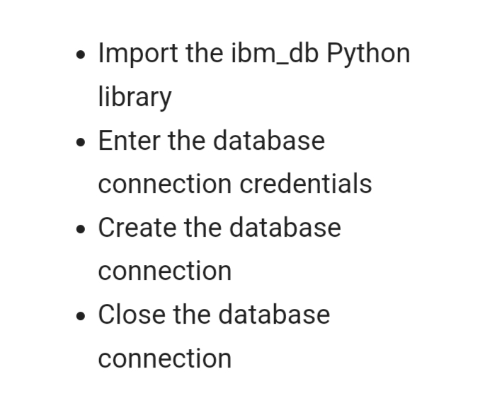
Connect to Db2 database on cloud using python:

Slide 3
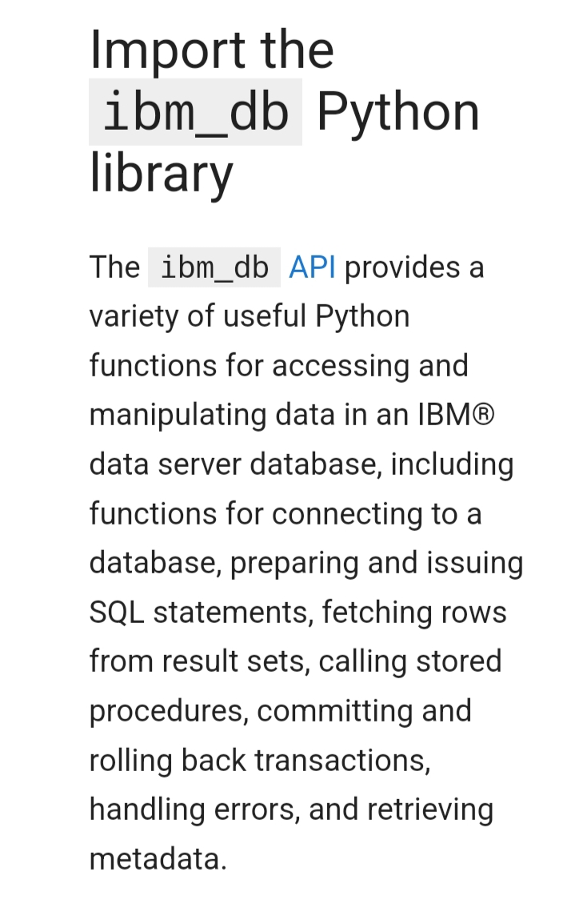

Slide 4
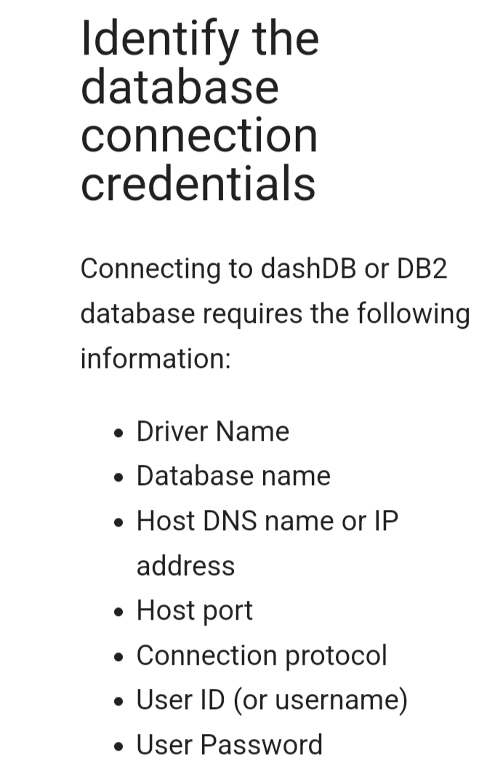

Slide 5
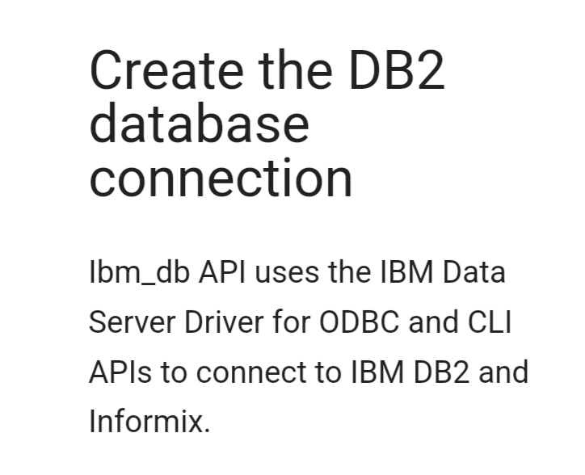

Slide 6


Slide 7
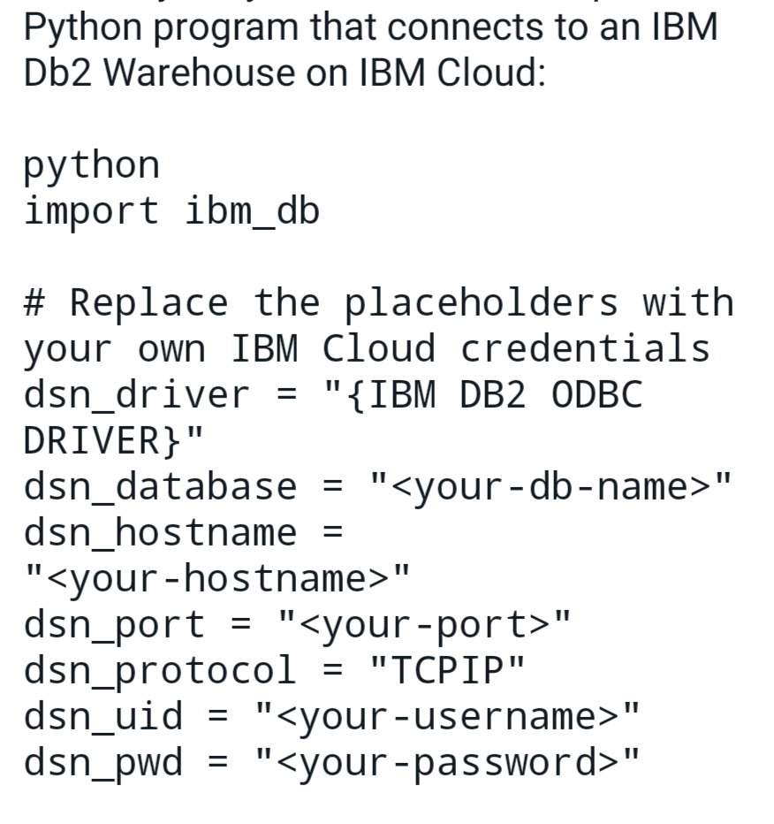

Slide 8
